Slide 1
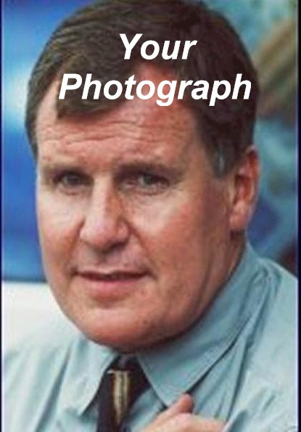
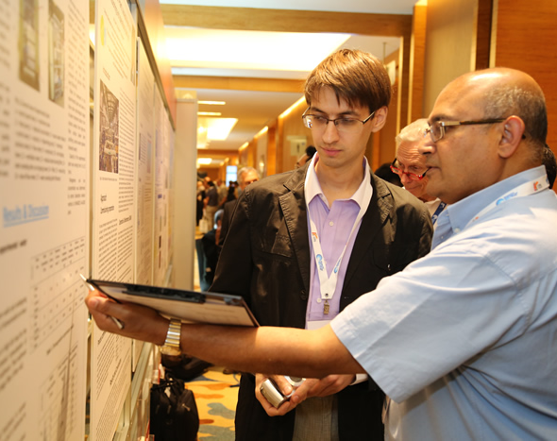
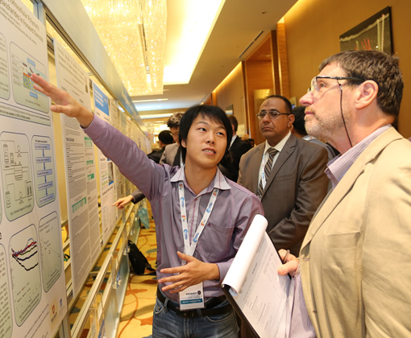
Sample layout for 80x120cm poster: The Title of Poster
[To be concisely and accurately specify its subject]
J. Royle*, C. D. Flesch* and E. Fowle**
* Department of Superficial Research, Agricultural University of Suffolk, XXXX Portman Road, Ipswich, xxxx, UK
(E-mail: xxx@xxxx.com; xxx@xxx.xxx.edu.uk)
** Bodgett & Billham plc, Hamilton House, Hangover Square, London NCXXXX, UK
Introduction
Methodology
[Start with a clear and pertinent overview of the research objectives; keep it within the limit of 300 words.]
Fill with text. Fill with text. Fill with text. Fill with text. Fill with text. Fill with text. Fill with text. Fill with text. Fill with text. Fill with text. Fill with text. Fill with text. Fill with text. Fill with text. Fill with text. Fill with text. Fill with text. Fill with text. Fill with text. Fill with text. Fill with text.
[Describe the experimental methods applied in this research work ]
Fill with text. Fill with text. Fill with text. Fill with text. Fill with text. Fill with text. Fill with text. Fill with text. Fill with text. Fill with text. Fill with text. Fill with text. Fill with text. Fill with text. Fill with text. Fill with text. Fill with text. Fill with text. Fill with text. Fill with text. Fill with text. Fill with text. Fill with text. Fill with text. Fill with text. Fill with text. Fill with text.
Figure 1: Example photograph
Figure 2: Example photograph
Results & Discussion
[Devote the main part of the poster to your results and discussion]
Information to Note:
The purpose of poster paper presentation is to promote informal discussion. It is a graphic display of a written manuscript. The poster presentation stands by itself as a summary of research and usually contains an overview of research objectives, experimental methods, materials, results and a discussion.
The organisers of this conference are committed to providing a high-calibre program and urge you to consider the preparation of your poster carefully. You are encouraged to make full use of your available space. Posters are not intended as a mechanism for advertising products or services. Posters consisting of commercial brochures describing products or services or that are not of appropriate quality may be rejected.
Presenters are encouraged to bring handout copies of their material and leave them for interested delegates to pick up and take away.
An interested individual who is not necessarily familiar with your field of expertise should be able to follow your poster.
To ensure this:
organise the poster units in an orderly manner for a logical flow from top to bottom or left to right
minimum font size to use (Calibri 32)
use headings and colour
Use white or light-colour for poster background
use large and high-resolution images and photographs (300dpi)
test your poster by laying it out and asking a colleague to critique it
do not attach typewritten sheets to the poster presentation, as it is impossible to read these from a distance
The soft copy poster can be sent in powerpoint or in PDF only.
Figure 4: Example graph
C/Q = 1/(b.qmax) + (1/qmax). C
Q = ( Co – C ) V / B
C/Q = 1/(b.qmax) + (1/qmax). C
Figure 6: Example Chart
Fill with text. Fill with text. Fill with text. Fill with text. Fill with text. Fill with text. Fill with text. Fill with text. Fill with text. Fill with text. Fill with text. Fill with text. Fill with text. Fill with text. Fill with text. Fill with text. Fill with text. Fill with text. Fill with text. Fill with text. Fill with text. Fill with text. Fill with text. Fill with text. Fill with text. Fill with text. Fill with text. Fill with text. Fill with text. Fill with text. Fill with text. Fill with text. Fill with text. Fill with text. Fill with text. Fill with text. Fill with text. Fill with text. Fill with text. Fill with text.
Figure 5: Example Equations
Conclusions
[Finish with a brief conclusion.]
Fill with text. Fill with text. Fill with text. Fill with text. Fill with text. Fill with text. Fill with text. Fill with text. Fill with text. Fill with text. Fill with text. Fill with text. Fill with text. Fill with text. Fill with text. Fill with text. Fill with text. Fill with text. Fill with text. Fill with text. Fill with text. Fill with text. Fill with text. Fill with text. Fill with text.
The authors would like to express appreciation for the support of the sponsors:

